Slide 1
Name to go here across 2 lines
Name to go here across 2 lines
Location: Ampitheatre, Melton
Date: 21 Jan, 2022
Time: 12pm – 6pm

Slide 2
Name to go here across 2 lines
Name to go here across 2 lines
Location: Ampitheatre, Melton
Date: 21 Jan, 2022
Time: 12pm – 6pm

Slide 3
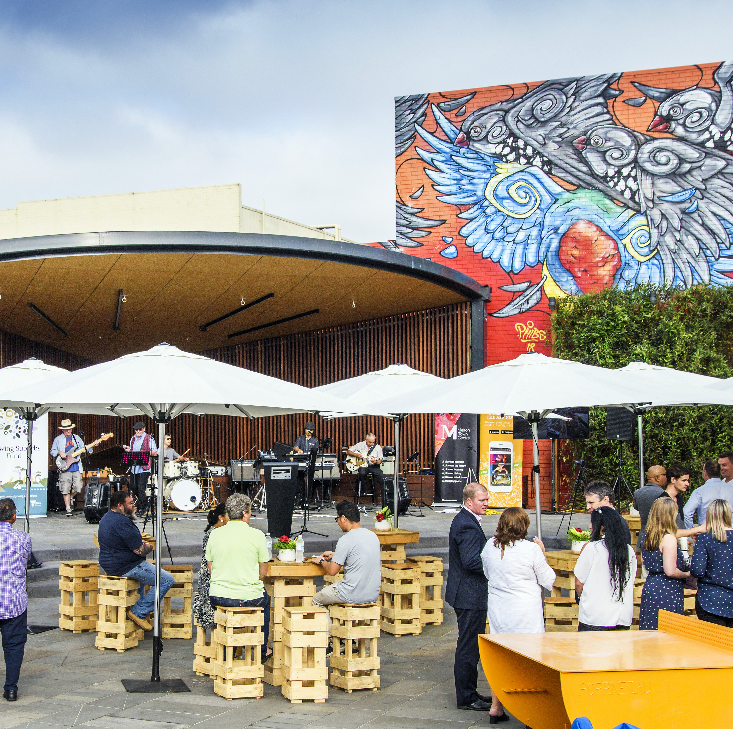
Name to go here across 2 lines
Location: Ampitheatre, Melton
Date: 21 Jan, 2022
Time: 12pm – 6pm

